Slide 1
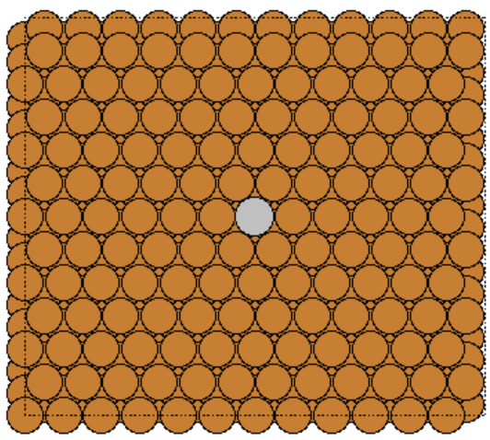
1 CO (0.7%)
Ead = -0.582 eV

Slide 2
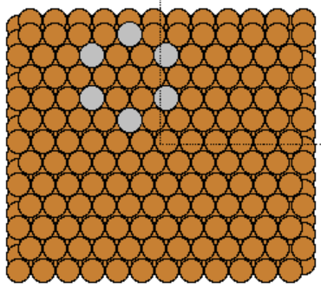
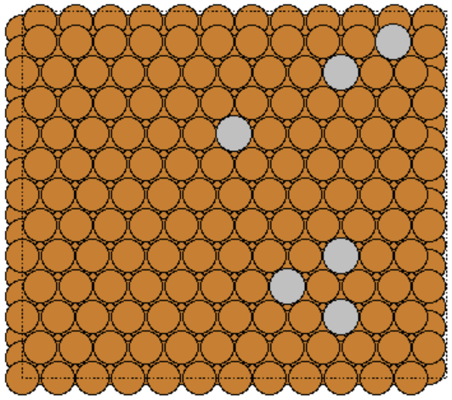
6 CO (4.2%)
Ead = -0.591 eV
Ead = -0.582 eV

Slide 3
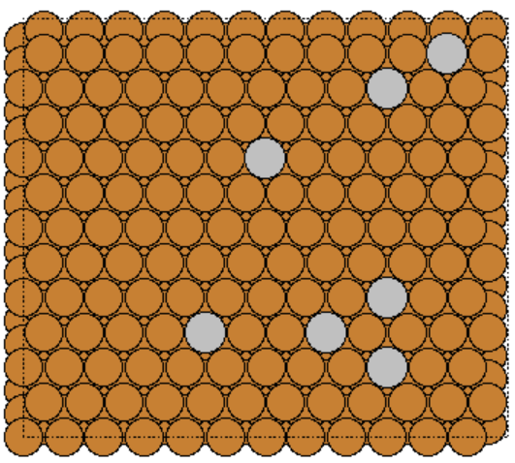
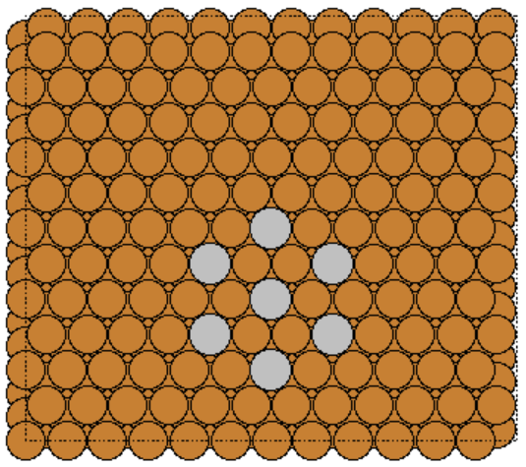
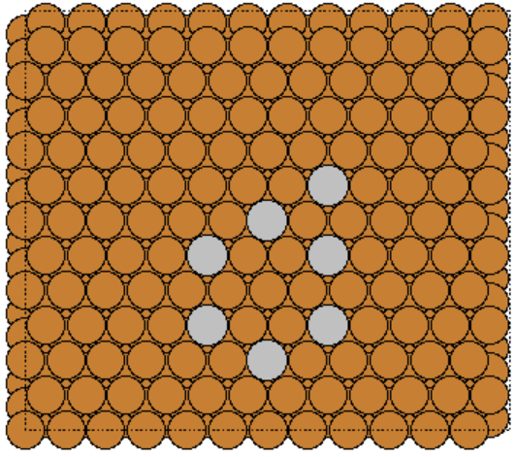
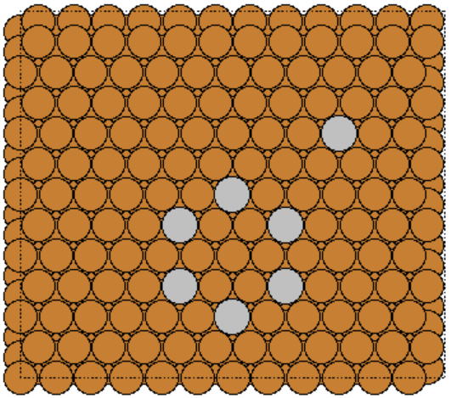
7 CO (4.9%)
Ead = -0.582 eV
Ead = -0.586 eV
Ead = -0.584 eV
Ead = -0.589 eV

Slide 4
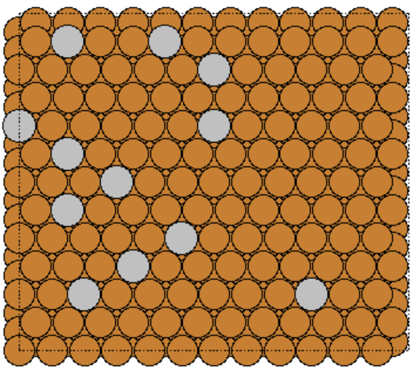
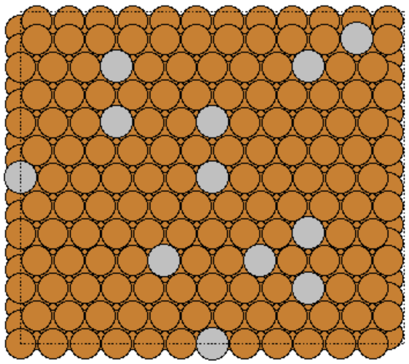
12 CO (8.3%)
Ead = -0.586 eV
Ead = -0.587 eV

Slide 5
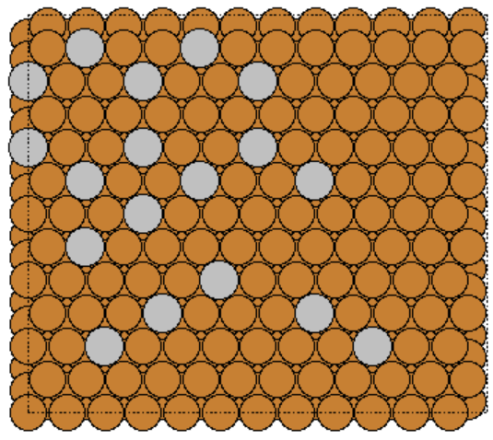
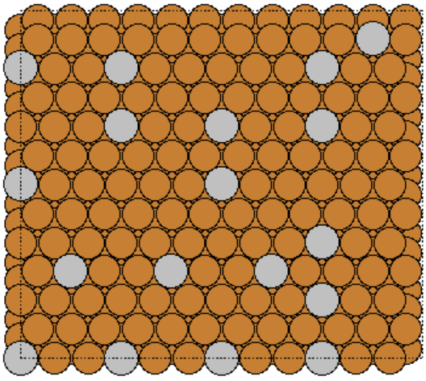
18 CO (12.5%)
Ead = -0.583 eV
Ead = -0.585 eV

Slide 6
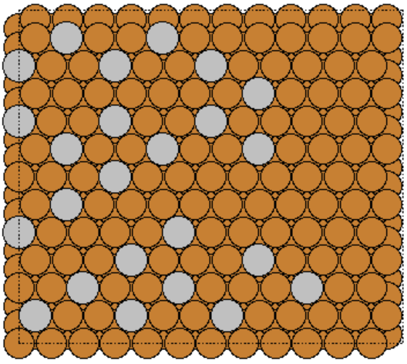
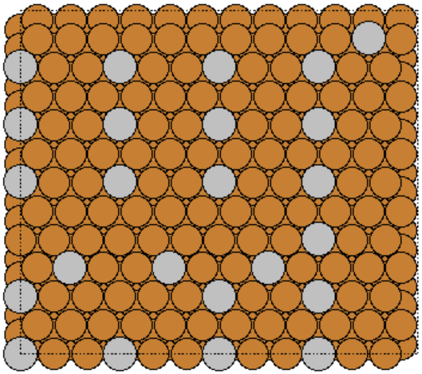
24 CO (16.7%)
Ead = -0.569 eV
Ead = -0.580 eV

Slide 7
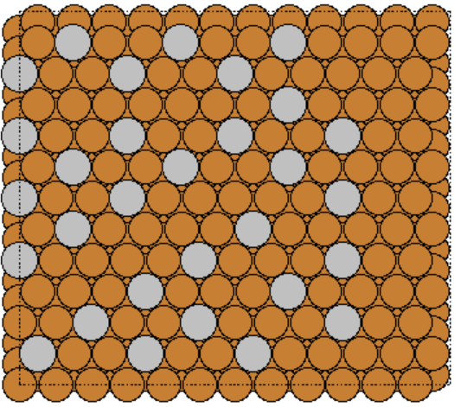
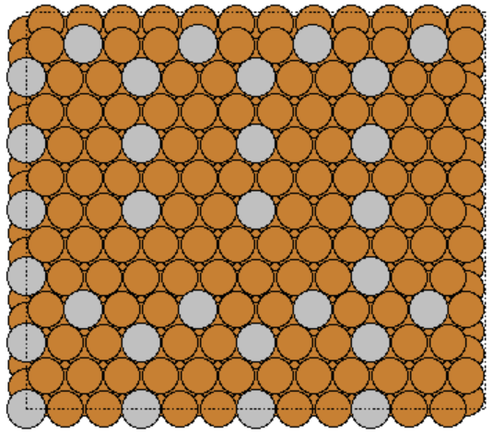
30 CO (20.8%)
Ead = -0.561 eV
Ead = -0.560 eV

Slide 8
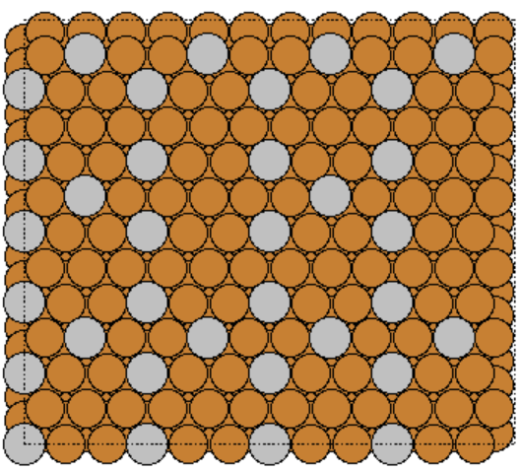
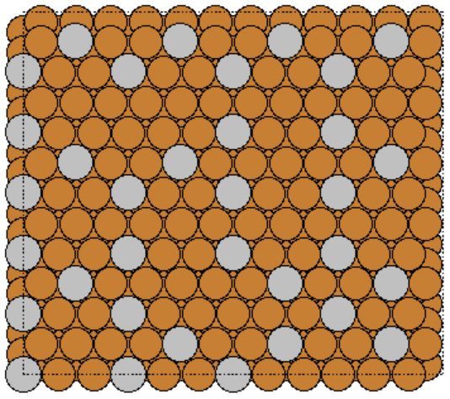
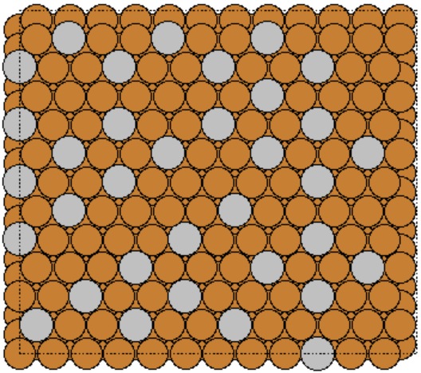
34 CO (23.6%)
Ead = -0.546 eV
Ead = -0.545 eV
Ead = -0.552 eV

Slide 9
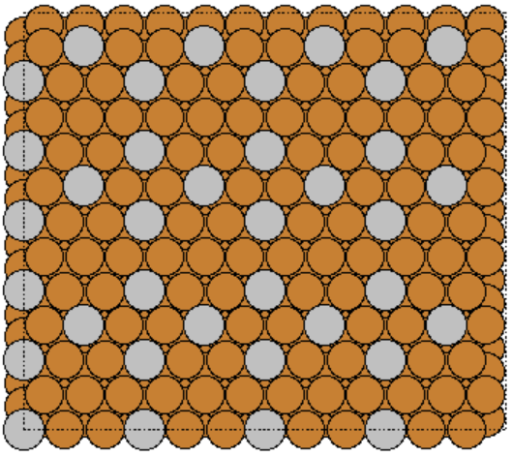
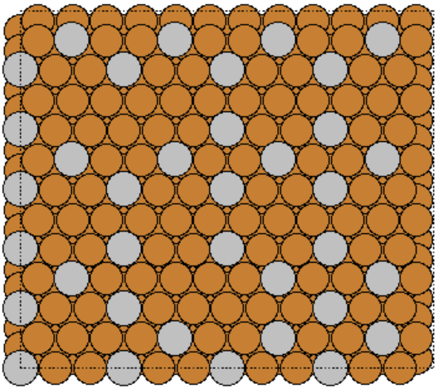
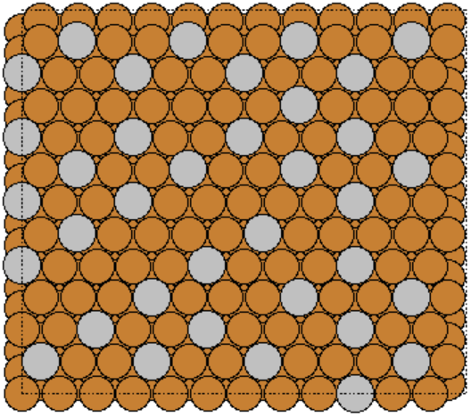
36 CO (25.0%)
Ead = -0.538 eV
Ead = -0.539 eV
Ead = -0.546 eV

Slide 10
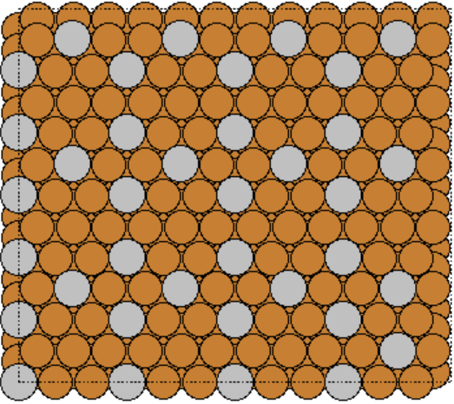
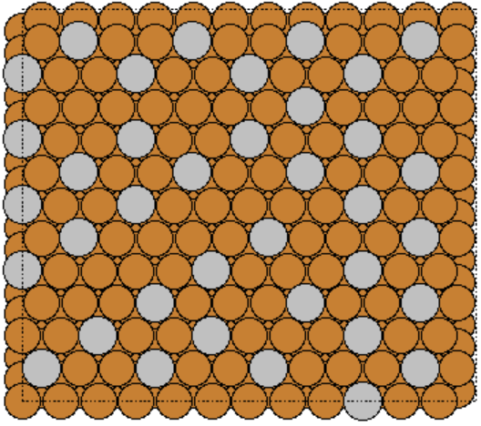
37 CO (25.7%)
Ead = -0.536 eV
Ead = -0.543 eV

Slide 11
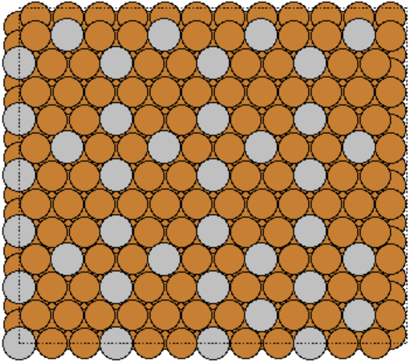
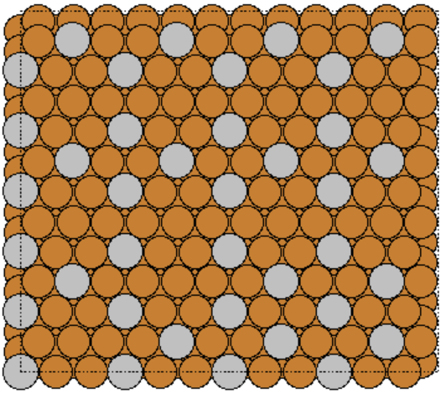
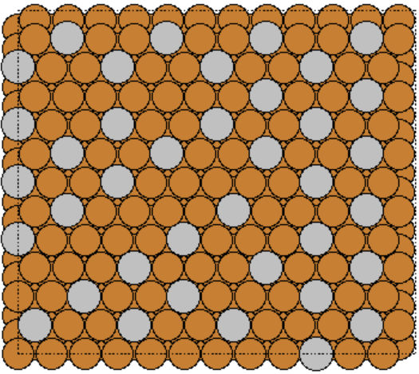
38 CO (26.4%)
Ead = -0.533 eV
Ead = -0.533 eV
Ead = -0.537 eV

Slide 12
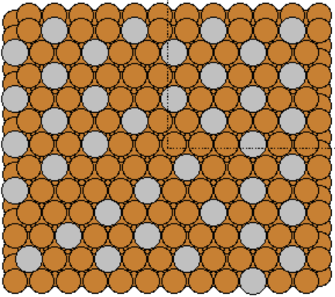
39 CO (27.1%)
Ead = -0.536 eV

Slide 13
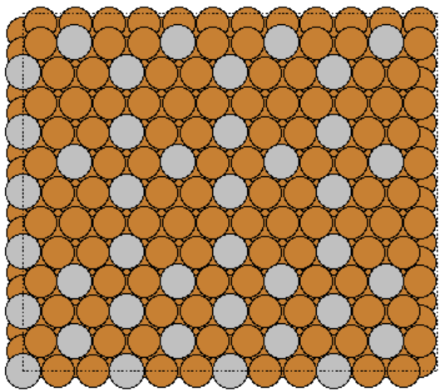
40 CO (27.8%)
Ead = -0.526 eV

Slide 14
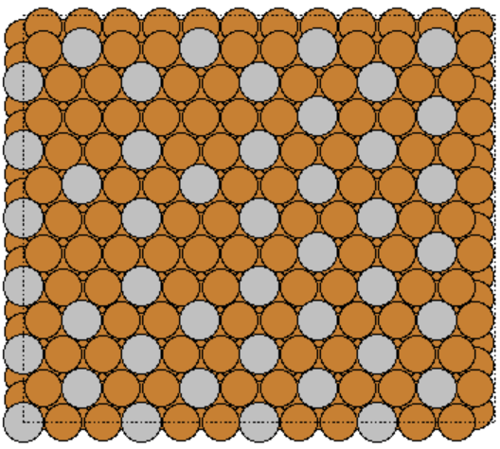
44 CO (30.6%)
Ead = -0.513 eV

Slide 15
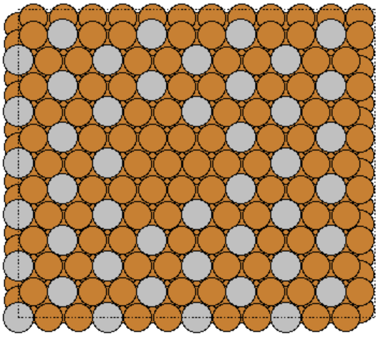
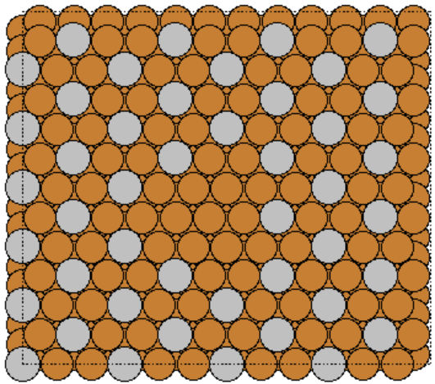
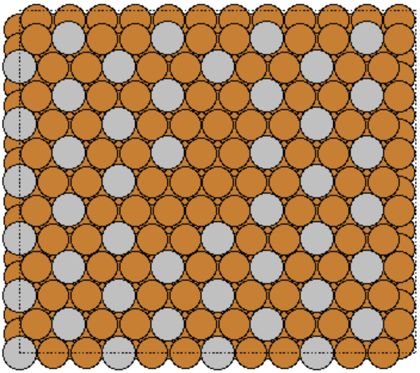
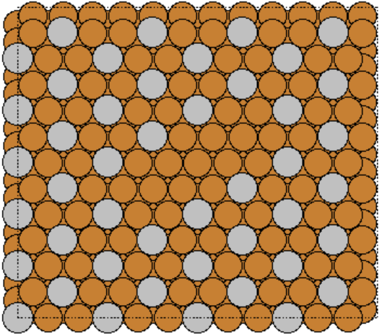
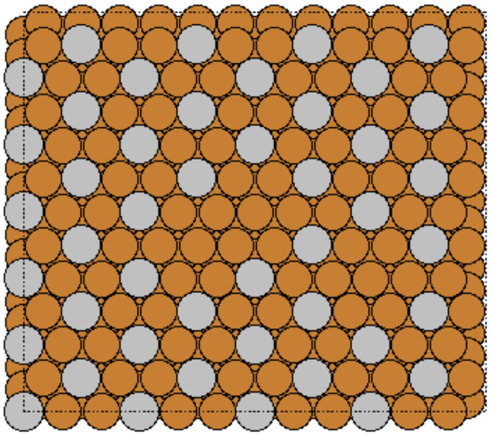
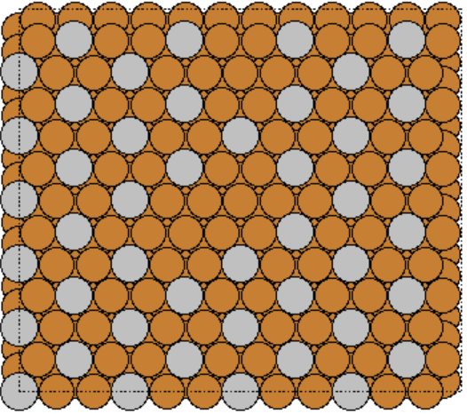
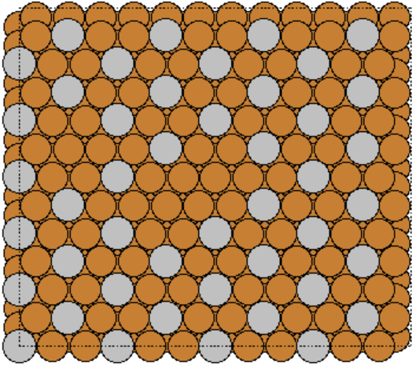
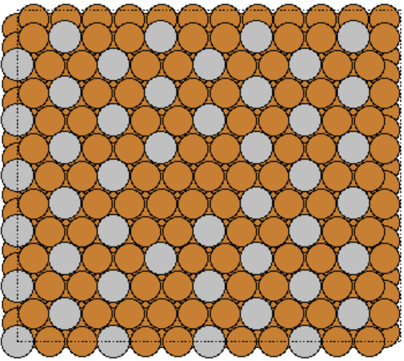
45 CO (31.3%)
Ead = -0.514 eV
Ead = -0.512 eV
Ead = -0.511 eV
Ead = -0.512 eV
Ead = -0.515 eV
Ead = -0.514 eV
Ead = -0.508 eV
Ead = -0.516 eV

Slide 16
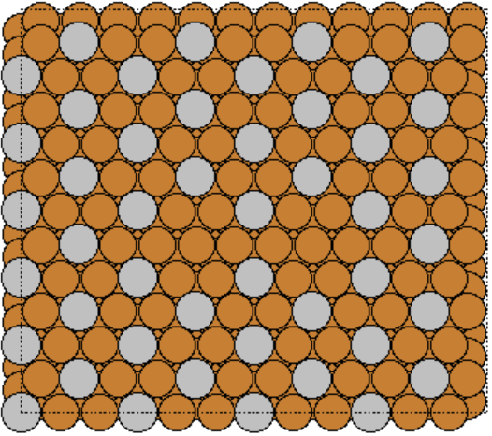
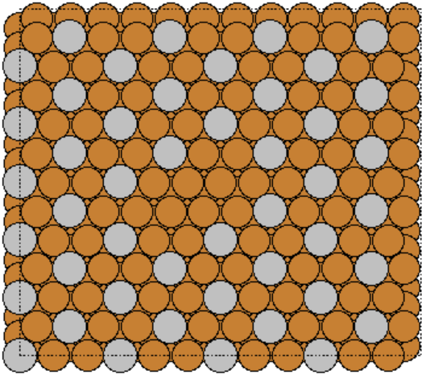
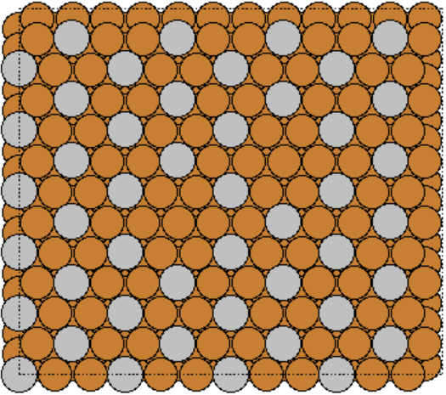
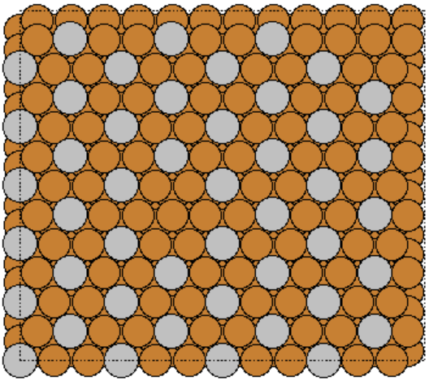
46 CO (31.9%)
Ead = -0.511 eV
Ead = -0.514 eV
Ead = -0.514 eV
Ead = -0.514 eV

Slide 17
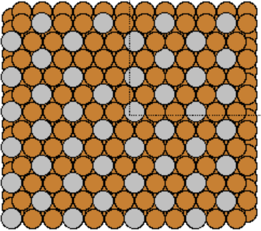
47 CO (32.6%)
Ead = -0.512 eV

